Slide 1
Advanced* Python workshop
Noam Cohen 2019-08
V 0.7
* Actually, this is intermediate level

Slide 2

Introduction
Audience: you already wrote some code in python.
We are not talking about syntax
Focus on language (python 3) and not on specific fields (e.g. data science)
Workshop format
3 days
3 * ( 1h lecture + 2 hour hands-on)
1 programming challenge.
K Pizza slices
Workshop’s site:
https://technionmail.sharepoint.com/sites/pythonworkshop2019

Slide 3

A few words on source code control (VCS)
What is VCS? Why do you need it?
Everybody use git. Learn it.
Search for “git best tutorial”
Try
Cry
Repeat until dry
All the course material is in github: https://github.com/noam1023/python_workshop_intermediate
Notes:
e.g. https://www.atlassian.com/git/tutorials/what-is-version-control

Slide 4
Remote Development
In this workshop you can (but don’t have to) use remote development on a server. This means that the PC/Mac only shows the source code but all the hard CPU work of is done remotely.
Setting remote development: (one way at least)
You need to have PyCharm 2019.1 and later Professional edition
Just follow the instructions on their site.
First, make sure you can connect with SSH to the remote server
Connection details: username / password
Notes:
I tried the first method (using local compilation and remote interpreter)
The second method requires TWO way connection so not possible behind firewall (unless I am mistaken)
The code runs on the remote, and stdout is seen in the IDE
Bravo!
https://www.jetbrains.com/help/pycharm/remote-debugging-with-product.html

Slide 5
And your challenge is…
Notes:
Link to the Challenge presentation

Slide 6

Basic Knowledge
Logging
Unit Testing
Memory model and parameter passing
Virtual environments and Packages
Exception Handling
Modules and Packages
Pip, pypi
Profiling and optimizations
Notes:
Syllabus at https://docs.google.com/document/d/1-a5sqkK6FUwHCfmMCsv2auJZcEwZSQ7TbYP2DRMGVDg/edit#

Slide 7
Advanced topics
Multi-threading and the GIL
Multiprocessing
Subprocess module
Generators and Iterator Protocol
Decorators (class and method based)
Comprehensions
Notes:
Day 3

Slide 8
Unit testing – why, how much
Without (unit) testing, only HALF of the code is run. This means that the other half (with error handling etc.) will be first executed in the field.
Peace of mind – check for regression after changes (i.e. did you break existing code with the new change). Identify the important parts and test only them.
“unit” – small piece of code doing one functionality.
Can get complicated if the tested object has dependencies on other objects.
(demo pycharm project) or screencast
Notes:
Demo:
Create a function, select, right click, generate test
Challenges:
Dependencies on external packages/ modules → this means the class is not ‘easily testable’ and should be refactored

Slide 9
Assert – what/why?
Guard against your own bugs and incorrect usage of your functions
Verify that conditions are kept: assert len(distances) == len(self.id_to_label)
def by_name(self, name):
id = self._name2id_map[name]
assert self._id2name_map[id] == name, “your [formatted] message here”
return id
Read it all here: https://wiki.python.org/moin/UsingAssertionsEffectively

Slide 10
Memory management
Automatic Garbage Collection using reference counting (+magic)
numbers = [1, 2, 3]
# Reference count = 1
more_numbers = numbers
# Reference count = 2
sys.getrefcount(numbers)
Where is the data stored?
→ Implementation dependent. In Cpython, all objects are stored in the heap, and the stack has reference to them.
Notes:
https://docs.python.org/3/c-api/memory.html
https://realpython.com/python-memory-management/
If you want to delete an object (rarely needed):
del the_object

Slide 11
Parameter passing: by value or by reference?
Neither!
“call by object reference” / call by name
Can be thought as:
Mutable -> call by reference
Imutable -> call by value
Notes:
https://www.python-course.eu/passing_arguments.php

Slide 12
Argument passing *args, **kwargs
Passing variable number of arguments
# Python program to illustrate (https://www.geeksforgeeks.org/args-kwargs-python/)
# *args with first extra argument
def myFun(arg1, *argv):
print ("First argument :", arg1)
for arg in argv:
print("Next argument through *argv :", arg)
myFun('Hello', 'Welcome', 'to', 'GeeksforGeeks’)
---------------------------
def myFun(**kwargs):
for key, value in kwargs.items():
print ("%s == %s" %(key, value))
myFun(first ='Geeks', mid ='for', last='Geeks')

Slide 13
More on names
‘When I use a word,’ Humpty Dumpty said in rather a scornful tone, ‘it means just what I choose it to mean–neither more nor less.’
‘The question is,’ said Alice, ‘whether you can make words mean different things–that’s all.’
‘The question is,’ said Humpty Dumpty, ‘which is to be master–that’s all’
What’s the problem here?
words = ['one', 'two','three']
for word in words:
if word == 'two’:
word = 'BOO!'
print(words)
word points to the 2nd cell in words
word points to a new string ‘Boo!’.

Slide 14
Virtual Environment
“virtualenv is a tool to create isolated Python environments. virtualenv creates a folder which contains all the necessary executables to use the packages that a Python project would need.”
Keep projects clean from each other.
Don’t contaminate your machine
python3 –m venv venv ← create ./venv and fill it with the binaries
source venv/bin/activate ← start using it
deactivate ← stop using it
(demo)

Slide 15
Exceptions (just reiterating what you learned)

Slide 16
Packages, modules and tree structure
https://realpython.com/python-modules-packages/
Module – can be imported (if in the path) (demo)
Know your import stuff
Module reloading (lazy)
Using __name__ for testing the module
Vars starting with ‘_’ are not imported (demo)
Subpackages: pkg.subpkg
Relative import path

Slide 17
The import processing https://docs.python.org/3/reference/import.html
Two operations:
searches for the named module/package,
Need fully qualified name
e.g. foo.bar.baz. In this case, Python first tries to import foo, then foo.bar, and finally foo.bar.baz. If any of the intermediate imports fail, a ModuleNotFoundError is raised.
In each intermediate, run __init__.py if exists
then it binds the results of that search to a name in the local scope
Importing is done once:
Module foo: print(“in foo”)
Module x and y both ‘import foo’ ➔ single print “in foo”

Slide 18
ImportError: cannot import name AsyncChecker
Cyclic reference!
server.py
import job_status
import show_jobs
from asyncChecker import AsyncChecker
asyncChecker.py
import threading
import subprocess
import re
from server import logger
Why the error?
server
AsyncChecker
logger
server
AsyncChecker
logger
Notes:
Topic: imports

Slide 19
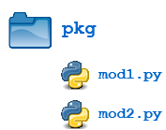
Packages
Simple name space by using the OS directories
Can use __init__.py in each package dir
from pkg.mod1 import Foo

Slide 20
Installing packages – some tools
pip (requirements.txt)
pipenv
conda
setuptools
(demo pip)

Slide 21
Optimizations (of what?)
Speed vs. memory?
Sometimes you can gain in both
How to find the hotspots?
Profiling tools ( Pycharm Pro, cProfile, …)
Use libraries (e.g Numpy) that uses native code
Write your own native code library (after you profiled your code)
“Early optimization is the root of all evil” (Confucius )

Slide 22
Code profiling
Guessing where the code is slow can be very misleading. Measure!
The measurement tool is called a Profiler.
Run your code with several inputs (to cover most common control flows)
We will see an example down the road (if there is enough time)

Slide 23
Python implementations
The default implementation is written in C, and is a stupid interpreter.
Alternatives: (both have JustInTime compilation)
Pypy : latest build (as of 2019-06) is compatible with cpython 3.5.3
jython : python that runs on JVM. The python code can call Java libs!
Notes:
It seems (from internet search) to me that both implementations are alive but are not popular.
Not clear if jython support for python 3 is stable

Slide 24
Introducing selected packages
scrapy – if you need to collect the data set yourself from a web site.
SciPy
NumPy
Pandas
scikit-learn
Notes:
Day 2

Slide 25
Advanced topics
Multi-threading and the GIL
Multiprocessing
Subprocess module
Generators and Iterator Protocol
Decorators (class and method based)
Comprehensions
Notes:
Day 3

Slide 26
Multi {threads, process}
How can we achieve concurrency?
Threads: all threads share the same memory
Processes: Each has its own memory space.
Due to historic limitation in Python implementation (Cpython), even multi threaded code in a multi core machine will run a single thread at time.
Solutions:
Use multiple interpreters (e.g. multiprocessing package)
Use a different python interpreter
Notes:
See for example https://www.toptal.com/python/beginners-guide-to-concurrency-and-parallelism-in-python

Slide 27
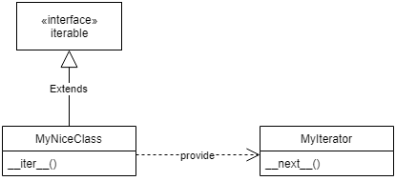
Iterators
Why the concept?
Separate the object from the iteration of it, and facilitate common interface to iteration.
a = {}
a.__iter__()
<dict_keyiterator object at 0x000001FF691E1BD8>
a.__iter__()
<dict_keyiterator object at 0x000001FF691E1CC8>
Multiple iterators for the same object

Slide 28
Generators https://www.programiz.com/python-programming/generator
Here is how a generator function differs from a normal function.
Generator function contains one or more yield statement.
When called, it returns an object (iterator) but does not start execution immediately.
Methods like __iter__() and __next__() are implemented automatically. So we can iterate through the items using next().
Once the function yields, the function is paused and the control is transferred to the caller.
Local variables and their states are remembered between successive calls.
Finally, when the function terminates, StopIteration is raised automatically on further calls
def reverse(data):
for index in range(len(data)-1, -1, -1):
yield data[index]

Slide 29
Decorators
Wrapping a function:
def my_decorator(func):
def wrapper():
print("Something is happening before the function is called.")
func()
print("Something is happening after the function is called.")
return wrapper
@my_decorator
def say_whee():
print("Whee!"

Slide 30
Decorators (more)
Use ready decorators from libraries:
import functools
@functools.lru_cache(maxsize=4)
def fibonacci(num):
print(f"Calculating fibonacci({num})")
if num < 2:
return num
return fibonacci(num - 1) + fibonacci(num - 2)

Slide 31
List comprehensions
Map and filter in one concise expression
>>> [x*x for x in range(4) if x % 2 == 0]
[0, 4]
Or use map() and filter():
>>> list(filter(lambda y: y%2 == 0,map(lambda x: x*x, range(4))))
(https://towardsdatascience.com/python-basics-list-comprehensions-631278f22c40)
Notes:
Personally I think it violates the “there should be one way of doing this” principle, but I agree it is more readable
The “if condition” is optional

Slide 32
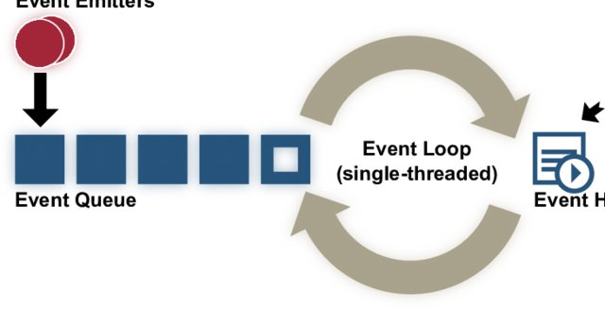
Asynchronous operations (just a taste)
Concurrent (not necessarily parallel) operations
Good fit for I/O bound
Not so good for CPU bound
Complicates the code
Considered as cool new paradigm
(Windows 3 used it in 1990)
Notes:
Complications:
Error handling is a nightmare
No clear stack trace to follow
Less readable (i.e. non readable)
you need to implement completion callback functions
await / async became keywords in python 3.7

Slide 33
More Advanced topics
Regular Expressions
Context Managers
Magic methods (__init__ . .. )
Alternative implementations (jython, pypy)
Static type checking
Notes:
Day 4

Slide 34
Regular Expressions
What is regex? “a sequence of characters that define a search pattern”
Check your expression here: https://regex101.com/

Slide 35
Context manager
Python’s with statement supports the concept of a runtime context defined by a context manager. This is implemented using a pair of methods that allow user-defined classes to define a runtime context that is entered before the statement body is executed and exited when the statement ends
This implements the concept of “auto release resource”
Examples:
Easy thread synchronization
File closing automatically

Slide 36
Magic methods
Operator overloading
>, => , + , len() etc.
Do not abuse it!

Slide 37
Alternative implementations
The ‘usual’ interpreter is Cpython
Non optimizing interpreter
Used as the reference implementation
Jython – execute the python byte code in java VM
Especially good if you need to use java libraries
Pypy – optimizing (JIT) interpreter written in python
IronPython - implementation in C#
Especially good if you need to use .NET libraries
Caveat Emptor: I did not try to use any of those

Slide 38
Static type checking
Optional package “mypy”
In development (requires python >=3.5)
You can add type hints (PEP 484) to your Python programs, and use mypy to type check them statically
from typing import Iterator
def fib(n: int) -> Iterator[int]:
a, b = 0, 1
while a < n:
yield a
a, b = b, a + b

Slide 39
More on Profiling
The cProfile module is part of the standard installation
$ python -m cProfile fib.py
584 function calls in 3.004 seconds
Ordered by: standard name
ncalls tottime percall cumtime percall filename:lineno(function)
1 0.000 0.000 3.004 3.004 fib.py:1(<module>)
577 0.000 0.000 0.000 0.000 fib.py:1(fib)
1 0.000 0.000 3.003 3.003 fib.py:8(noop)
<…>
Notes:
Simple text based output

Slide 40
Memory profiling – will my data fit in the RAM?
Python 3.6.8 (default, Jan 14 2019, 11:02:34)
[GCC 8.0.1 20180414 (experimental) [trunk revision 259383]] on linux
>>> import sys
>>> sys.getsizeof([])
64
>>> sys.getsizeof([4])
72
>>> sys.getsizeof([4,5])
80
>>> sys.getsizeof({})
240
>>> sys.getsizeof({1:[4,5]})
?
240
Notes:
In python 32 bit, each integer is 4 bytes.
In python 64 bit, each integer is 8 bytes.

Slide 41
Profiling output that’s looks nice
See for example https://julien.danjou.info/guide-to-python-profiling-cprofile-concrete-case-carbonara/
$ python -m cProfile -o myscript.cprof myscript.py
$ pyprof2calltree -i myscript.cprof
Then open kcachegrind on your machine and feed it with the converted file.
Notes:
pip install pyprof2calltree

Slide 42
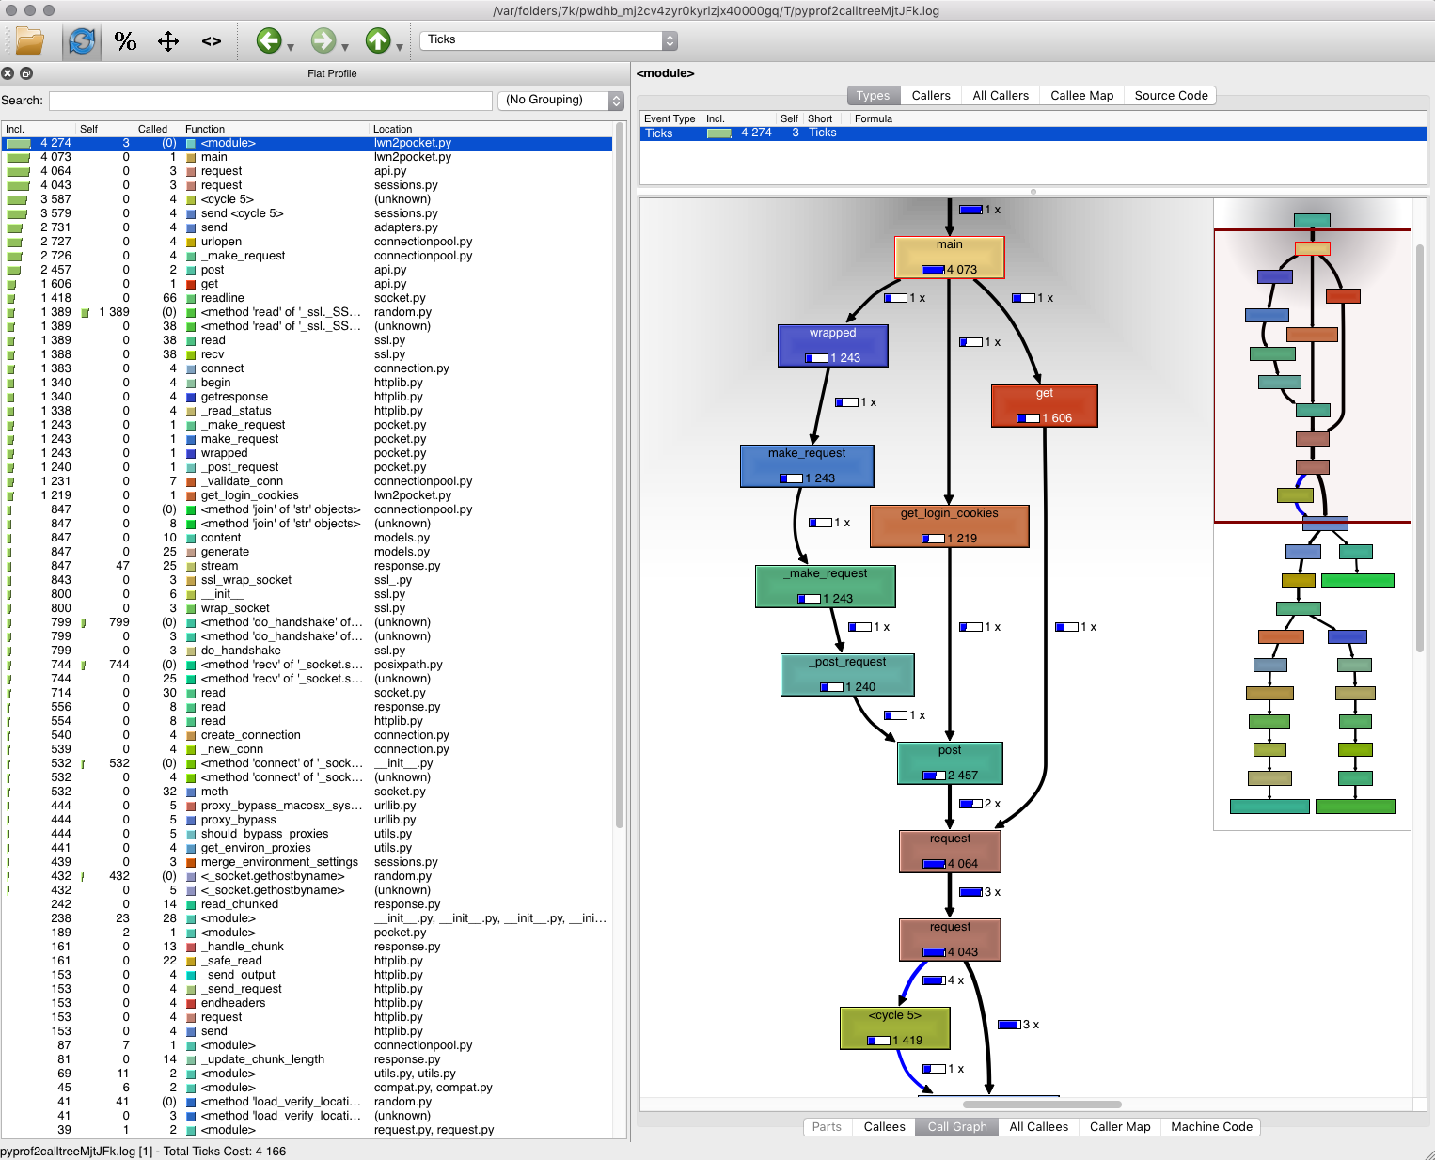
https://julien.danjou.info/guide-to-python-profiling-cprofile-concrete-case-carbonara/

Slide 43

Recommended reading
The Hitchhiker’s Guide to Python https://docs.python-guide.org/
Learning Python https://www.oreilly.com/library/view/learning-python/1565924649/
https://docs.quantifiedcode.com/python-anti-patterns/
index.html
THE formal documentation: https://docs.python.org/3/
How the interpreter works: https://www.aosabook.org/en/500L/a-python-interpreter-written-in-python.html
Fluent Python

Slide 44
More Recommended reading
https://jakevdp.github.io/PythonDataScienceHandbook/

